Slide 1


PRESENTATION ON Improvement of Power using Direct Current Control method of STATCOM
RAJIV GANDHI COLLEGE OF ENGINEERING & RESEARCH, NAGPUR Department Of Electrical Engineering
5th National Conference on Information Communication Technology NCICT-18
5TH January,2019
Presented By
Sanjyot Ramteke 5. Takshak Raul
2 Toshik Ghormare 6. Tinkesh Bhanarkar
3. Tushar Giripunje 7. Piyush Ganorkar
4. Pankaj Dhongale
Under Guide of
TRIPTI RAI

Slide 2
CONTENTS
INTRODUCTION
PROGRESS CARRIED OUT TILL DATE
PLAN FOR VIII SEMESTER
REFERENCES

Slide 3
OBJECTIVE
The grid connected transmission line system
for power quality improvement by using STATCOM has
the following objectives.
• To maintains power factor as unity at the source end.
• To meet the reactive power to non-linear load.
• To eliminate the harmonic contents by using STATCOM .

Slide 4
INTRODUCTION
With the rapid development of industry, the requirements of electric power quality are becoming stricter.
Improvement in the reliability, controllability and rapidity of modern power system has become a urgent problem to be solved.
Reactive power and voltage regulation are the major issues in power system operation.
Power quality mainly deals with,
• Continuity of power supply.
•Quality of the voltage.
Various power quality problems may leads to another
undesirable problems like voltage variations, harmonics, flickers.

Slide 5
• So, in order to mitigate this problems, Flexible Alternating Current Transmission System (FACTS) is used to enhance controllability and increase power transfer capability of the network.
• Series Devices - SSSC,TCSC
• Shunt Devices - STATCOM,SVC
• Series-series devices - IPFC,UPFC
• Series-shunt devices - HVDC link
• So, in order to improve power quality by reducing all such problems STATCOM is used .
In this project, we generally focued on STATCOM and it’s working in transmission line.

Slide 6
CIRCUIT DIAGRAM
UT
Coupling
Transformer
Iq
U
Voltage
Source
Converter
Controller
Vdc
Idc
DC Energy Source
Cdc

Slide 7
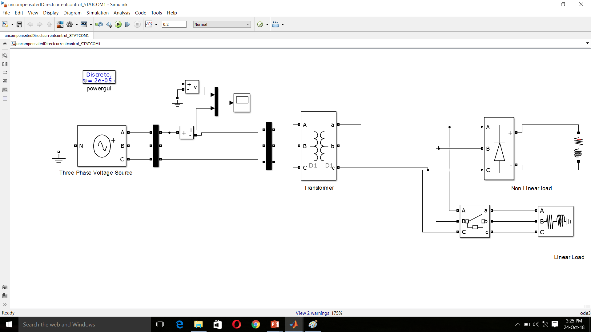
Progress Carried Out Till Date
SIMULATION BEFORE COMPENSATION

Slide 8
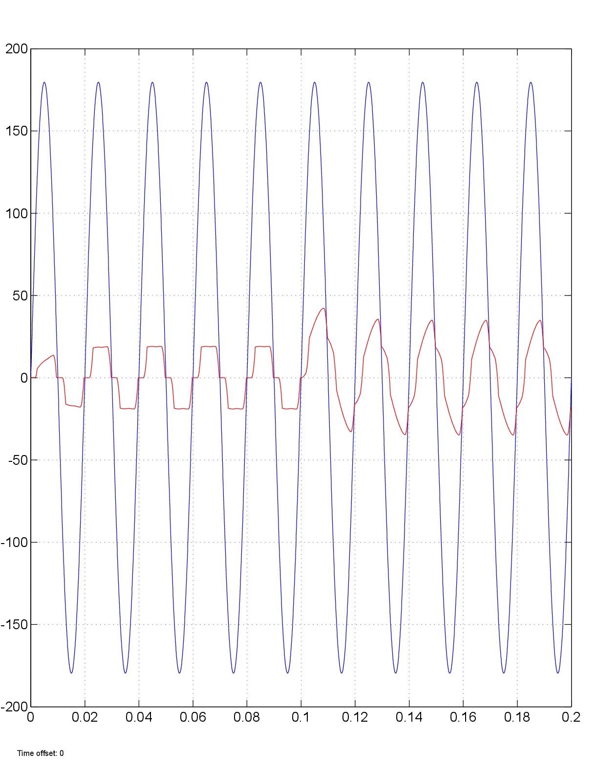
Output Waveforms Before Compensation
Voltage & current [volts/amps]
Time [secs]

Slide 9
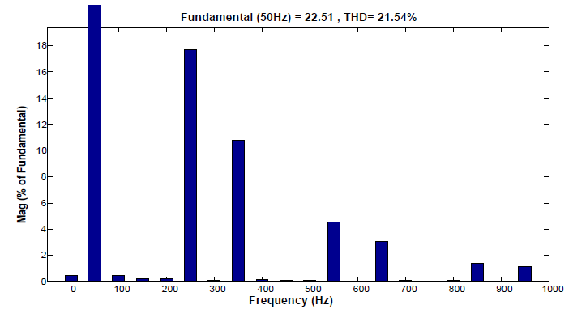
Current waveform Harmonic (FFT) analysis

Slide 10
REFERENCES
The Direct Current Control Method of STATCOM and its simulation.2013 Third International Conference on Intelligent System Design and Engineering Applications.
Nagrani G. Hingorani , Laszio Gyugyi. Understanding of FACTS Concepts and Technology of Flexible AC Transmission System . IEEE Press 1999.
Using STATCOM Interfacing of Renewable Energy Sources to Grid and Power Quality Improvement. 2015 International Conference on Energy System and Applications.
P.S. Bhimra , Power Electronics.
Improvement of Voltage Quality in AC Network by use of STATCOM -2005Mazurov M.I.,Nikolaev A.V.,Lozinova N.G

Slide 11
THANK YOU

